Slide 1
冒險故事
(Animaze)

Slide 2
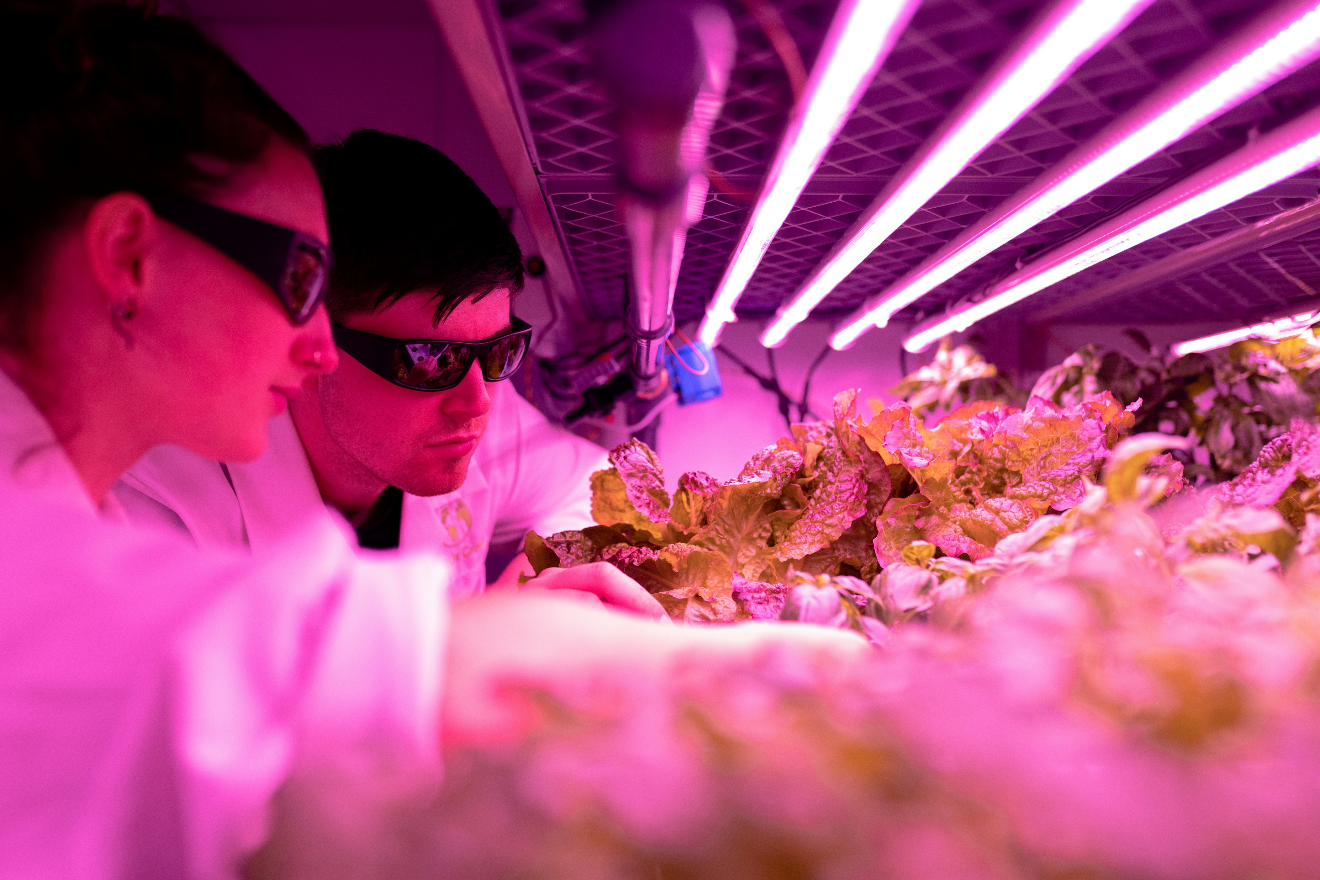
1.目標
Notes:
(https://unsplash.com/photos/woman-in-pink-long-sleeve-shirt-wearing-black-sunglasses-FDzh1--azLM)

Slide 3
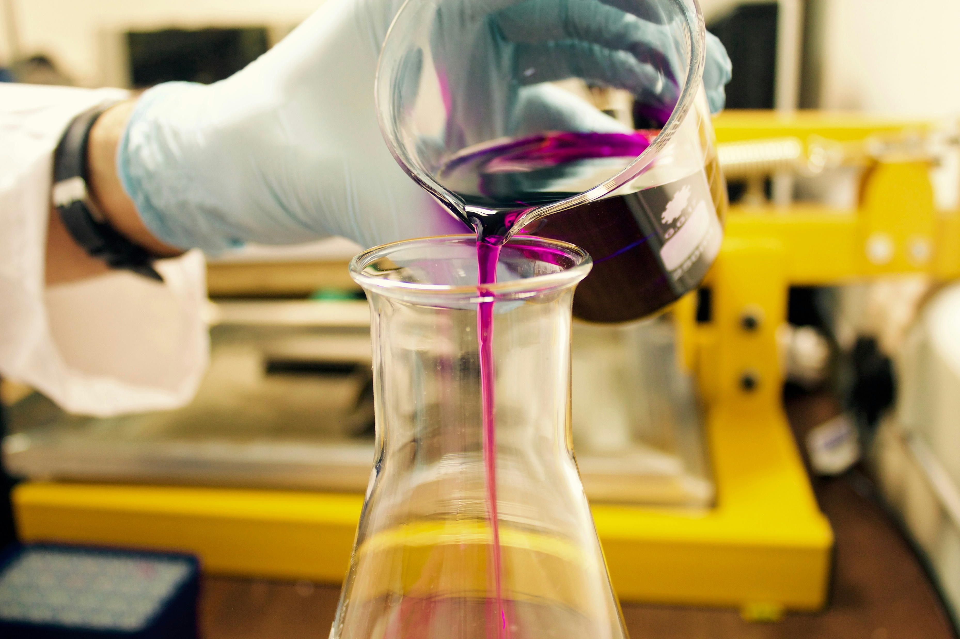
2.阻礙
Notes:
(https://unsplash.com/photos/person-pouring-purple-liquid-on-clear-glass-container-JeInkKlI2Po)

Slide 4
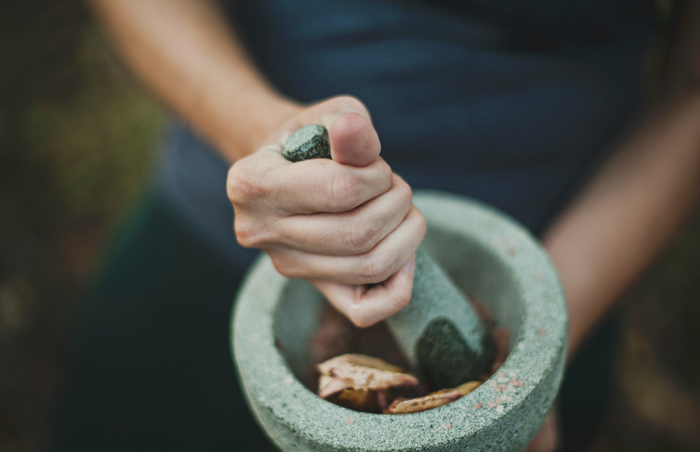
3.努力
Notes:
(https://unsplash.com/photos/person-grinding-on-mortar-and-pestle-bd_fCZhy_W8)

Slide 5

4.結果
Notes:
(https://unsplash.com/photos/persons-left-arm-on-green-leaves-JLpDkdcuceI)

Slide 6
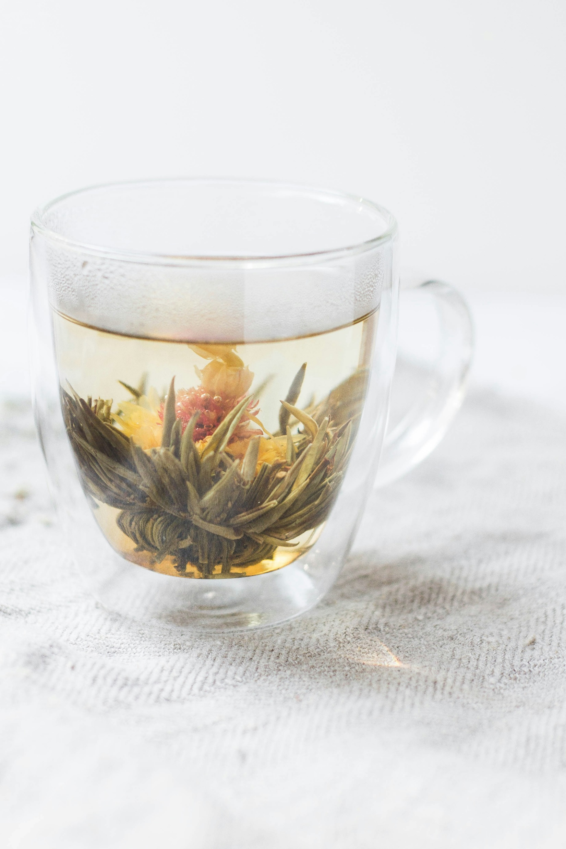
5.意外
Notes:
(https://unsplash.com/photos/photo-of-clear-glass-mug-vtntD9h1xBw)

Slide 7
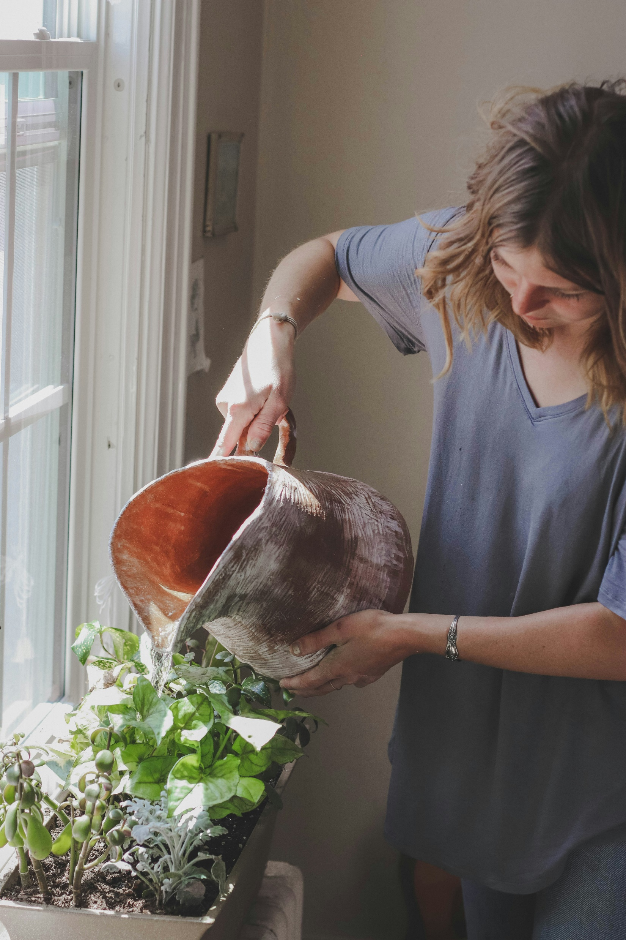
6.轉彎
Notes:
(https://unsplash.com/photos/woman-watering-plant-beside-window-EOJRrenjc4c)

Slide 8
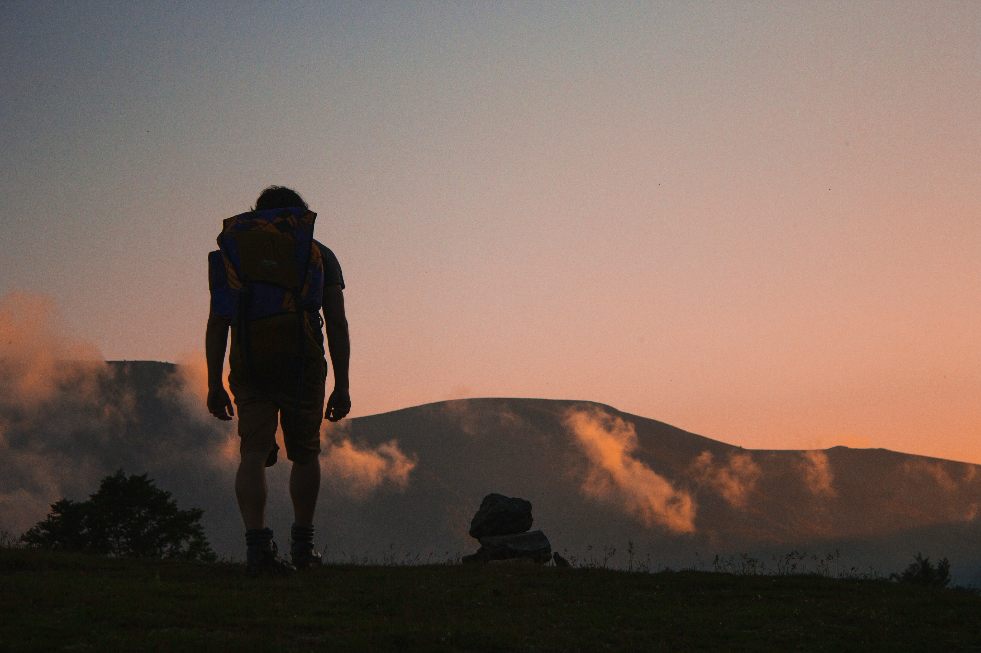
7.結局
Notes:
(https://unsplash.com/photos/silhouette-of-man-walking-along-field-leading-to-mountain-tPKQwYHy8q4)

